Slide 1
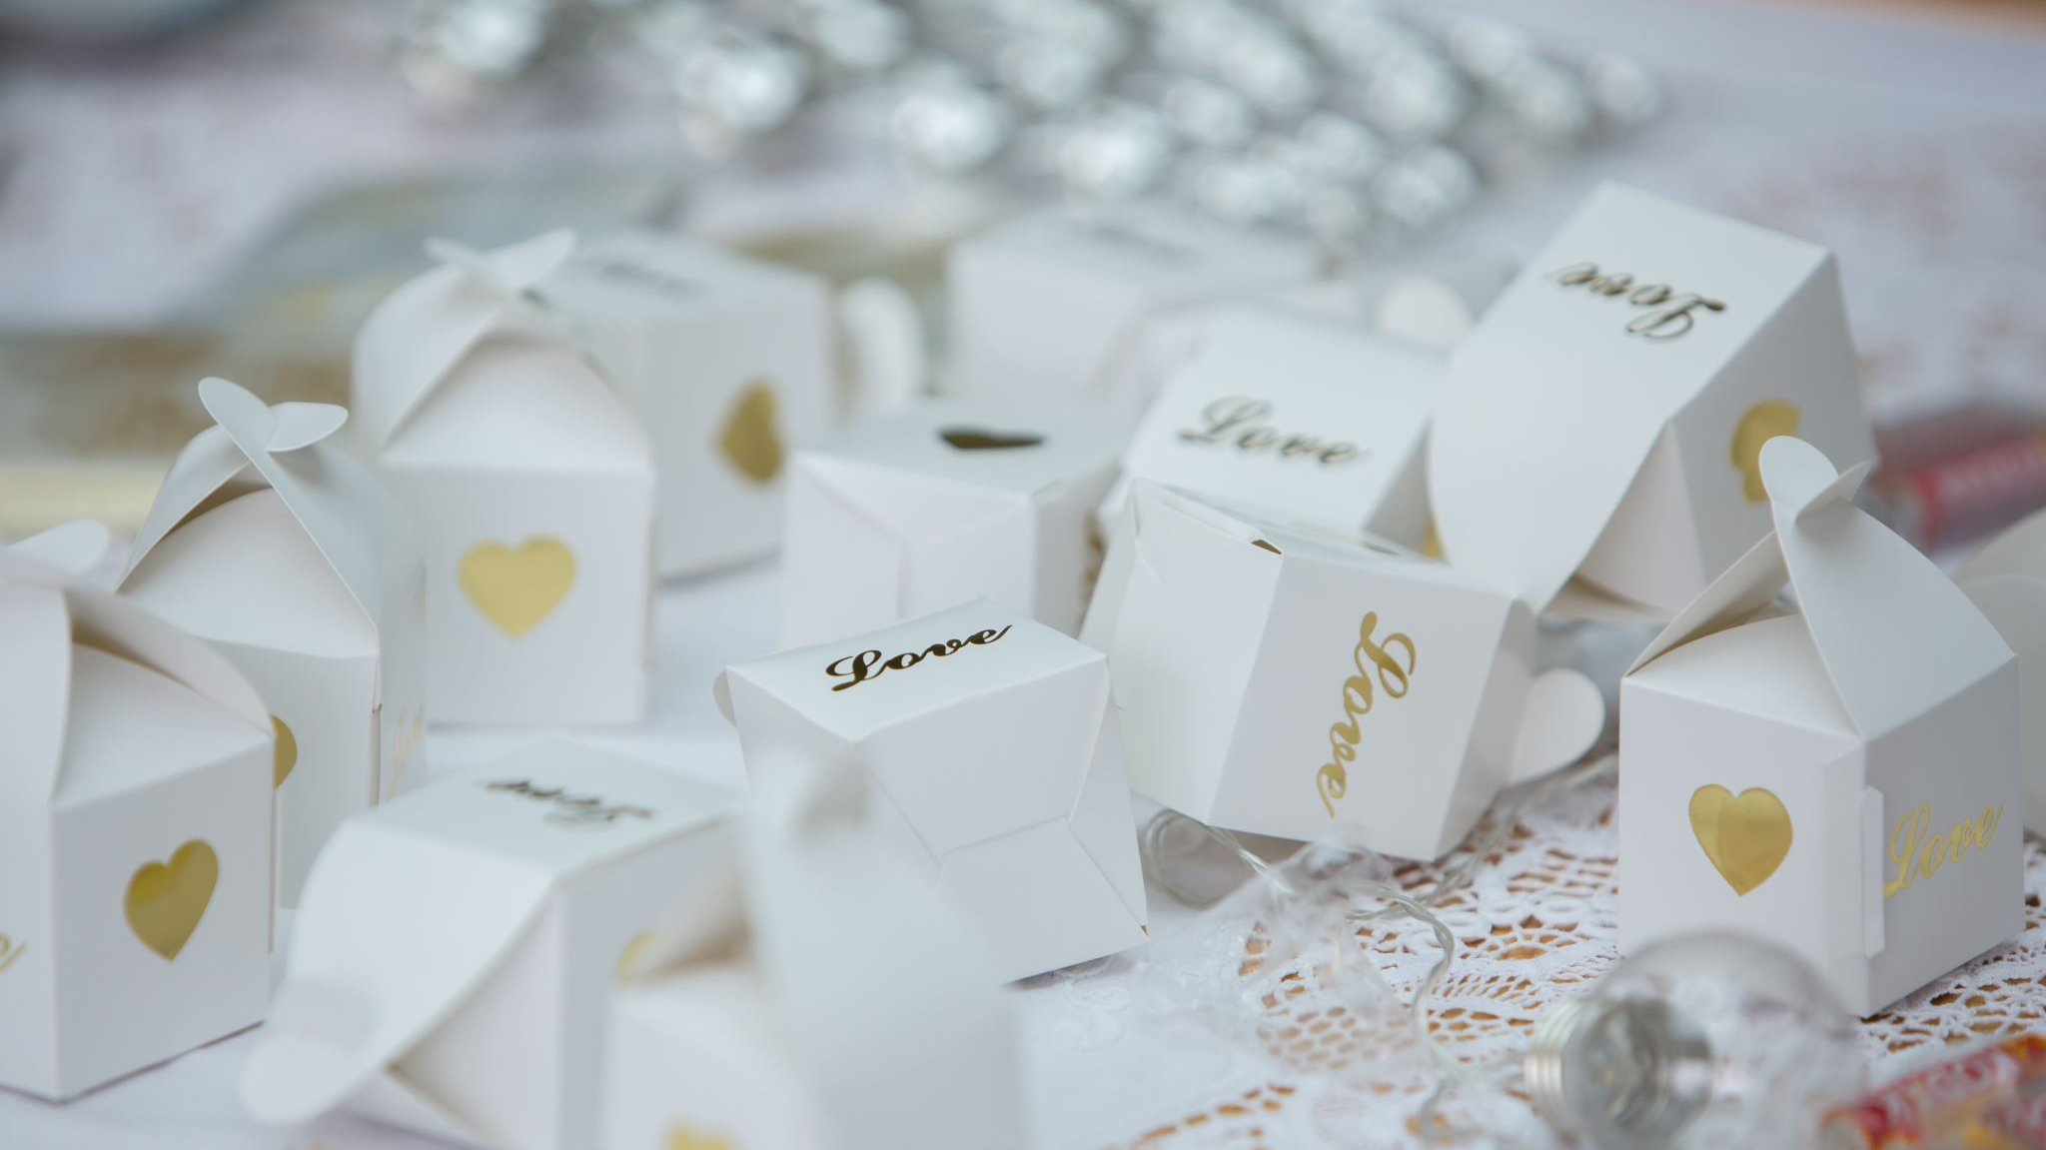
WEDDING PROJECT
GROUP 6
Nishant Bhardwaj (404)
Aman Sareen (411)
Rahul Bhutra (418)
Daksh Kapoor (424)
Prateek Rai (434)

Slide 2
SITUATION
The Family of the bride and groom wants to host a royal wedding for them at Jaisalmer with all close family and friends.

Slide 3
Assumptions
We will be able to find vendors who can accommodate our budget and are available on the date of our wedding
All important family members and friends will be able to attend
Money provided for the budget will be available when needed

Slide 4
PROJECT OBJECTIVE
The project goal is to hold the wedding on July 15th 2022.
The project manager Daksh Kapoor will be responsible for providing the sponsors, groom and bride with the project status on a weekly basis.

Slide 5
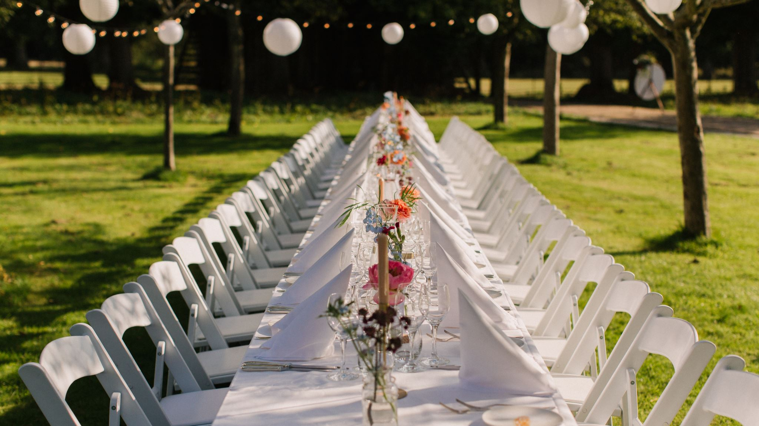
PROJECT OBJECTIVE
Host the wedding successfully at Suryagarh in Jaisalmer.
Arrangement of flight tickets and hotel accommodations for all the guests on specified dates.
Arrangement of wedding attire for the bride and the groom.
Catering arrangements and theme decorations at the hotel for wedding ceremonies.
Arrangement of special highlights like music night, pool party etc.

Slide 6

PROJECT MILESTONES
Confirmation of flight tickets and hotel reservations.
Booking of Music Band and DJ.
Wedding attire for the bride and the groom.
Arrangement of Catering and theme decorations.
Arrangement of Photographers & Makeup Artist.

Slide 7

PROJECT SCOPE
Wedding Party.
Wedding Venue.
Transportation
Officiant
Guest List and Invitation
Wedding Attire
Makeup Artist

Slide 8

8. Photographers
9. Organizing Wedding Rituals
10. Food Service
11. Decorators
12. Entertainment
13. Gift for Guests
14. Arrangement of Ghori and Doli

Slide 9
PROJECT DESCRIPTION
1. To host the wedding at Suryagarh in Jaisalmer with accommodation of guests of 300 for 3 days.
2. function hall for 2 days for wedding ceremonies.
Deliverables
1. Invitations to guests at least 2 months before the date.
2. Flight tickets for all guests and family 1 month prior the function.
3. Pre wedding shoot 1 month before the wedding
4. Attire for both bride and groom, starting the preparation 2 months before the date.
5. Theme Decoration-RAJPUTANA, decorations for day 1 and day 2 will be ready before the arrival of guests.
6. Photography and Videography, they will be available before the guests arrives.
7. All the Rituals and the materials required will be ready beforehand separate bag for each ritual and will be available then.
8. Music band , Vintage Car Dulha Wedding Entry and Bride’s Doli Arrangement will be booked 1 month prior the date of wedding.
9. Welcoming the guests and escorting them to their allotted rooms.

Slide 10
CONSTRAINTS, ASSUMPTIONS, RISKS AND DEPENDENCIES
Constraints Assumptions | Budget not to exceed 90 lakhs. All arrangements are time bound.
 | Flights and hotel are available on the specified dates as well as the ceremonies.
Risks and Dependencies | · Missing of the flight of guests coming from outstation, arranging smooth transportation. · All the booked Vendors to arrive on time.

Slide 11
LIMITATIONS AND EXCLUSIONS
1. Transportation service of guests and family members will be included i.e., Airport pickup and drop as well as food.
2. Jewelry ,rings and gift items will not be included.
3. Covid treatment expenses won't be covered.
4. Any guests missing the flight or train.

Slide 12

ALL THE RITUALS UNDER ONE ROOF

Slide 13
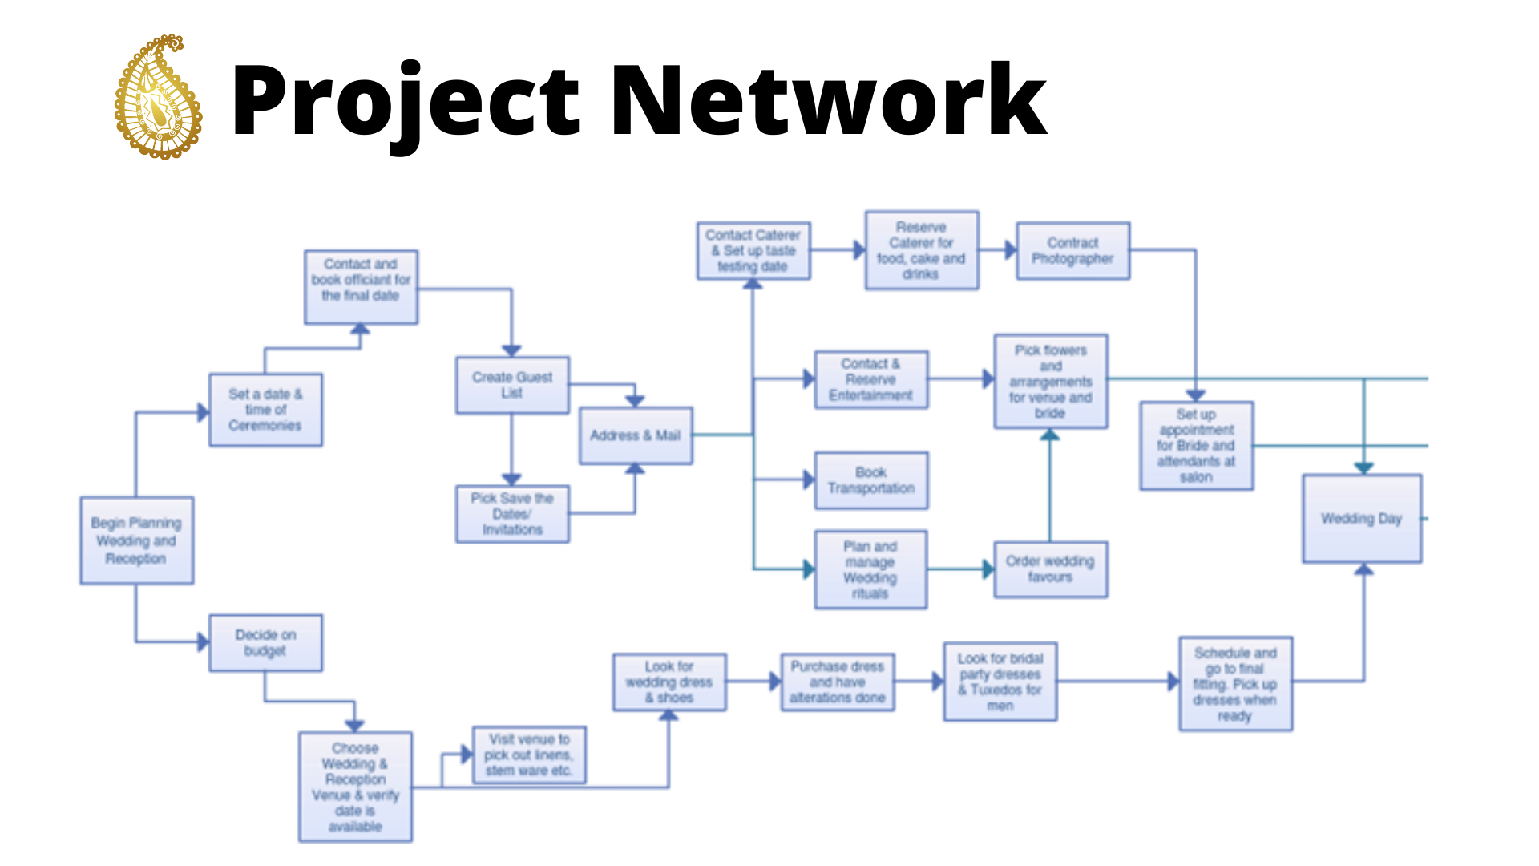
Network Diagram

Slide 14
CONTRIBUTION AND ACCOUNTABILITY
TASKS | Saurabh | Faraz | Aditi | Lavisha | Shilpi
Create guest list | S | I | - | - | R
Print the invitations | - | C | S | I | R
Mail the invitations | - | - | C | S | R
Wait for RSVPs | S | - | S | - | R
Finalize the number of rooms required | R | S | I | A | -
Select the hotel | R | S | C | - | -
Book the rooms | R | S | - | C | S
Find the caterer | C | - | R | S | -
Finalize the menu | A | C | R | S | -
Finalize the number of serves | A | - | R | S | A

Slide 15
TASKS | Saurabh | Faraz | Aditi | Lavisha | Shilpi
Selecting the Décor Vendor | - | S | - | R | C
Selecting DJ, Music Band | R | C | A | - | -
Cater wedding | C | S | R | S | -
Shop for the dress | S | A | - | R | S
Booking Tickets | S | - | A | R | C
Buy gift for Guests | - | - | C | A | R
Choose halls and lawns | S | A | - | R | C
Tailoring and fitting | S | C | A | R | -
Makeup | S | - | A | R | C
Finalize the Iist of events | A | R | - | A | S

Slide 16
TASKS | Saurabh | Faraz | Aditi | Lavisha | Shilpi
Buying all the ritual materials | - | - | R | A | C
booking for ghori and doli
Identify the service provider | C | R | A | S | S
Pay Advance to book | A | R | A | - | S
RASIC-Responsible, Approving, Supporting, Inform, Consulting

Slide 17
IT’S PREFERRED TO BOOK THE LOCATION WAY BEFORE TO AVOID IT’S CHANGE

Slide 18
TIME ESTIMATION
April 21, 2022 – April 30, 2022
Set wedding date; select and reserve hotel, Work on the guest list; Select and reserve a photographer, videographer, florist, DJ or musicians, and a caterer; Begin to plan the menu; Select and order wedding invitations, bride and Groom Clothes, announcements, thank you notes.

Slide 19

June 01th,2022 – June 28th, 2022
Finalize guest lists; mail the invitations; Order any party favors; Decide on reception decorations and order or begin making them; Arrange for transportation on the wedding day.

Slide 20

June 20th ,2022 – June 25th, 2022
Keep a record of RSVPs and gifts received; Finalize menu for the reception; Finalize the wedding flowers with florist; Confirm reservations and details with photographer, caterer, DJ, videographer, baker and any other professionals, including any special photos wanted, specific music during a first dance

Slide 21

LET THE FESTIVITIES BEGIN

Slide 22
ESTIMATED BUDGET
Activity | Budget | Amount (in Rs.) | Details
Hotel Accomodation | 42% | 35,00,000 | Room Accomodation., Halls, Lawns
Music | 8% | 7,00,000 | Ceremony Music, Cocktail hour music, DJ Fee, Ghori, Barat band, etc.
Flowers | 2% | 1,30,000 | Bridal bouquet, wedding party flower, table centrpieces, ritual decorations
Wedding Attire | 10% | 8,50,350 | Wedding gown, Dress Alterations, shoe, hair, makeup
Pandit (Priest) | 1% | 1,11,000 | Everthing related to ceremony and Priest Fee
Invitations | 1% | 80,000 | Wedding Cards, RSVPS
Transportation | 9% | 7,50,000 | Air Fare, Cab, Bus, Fuel Cost
Food | 15% | 12,80,000 | All meals of all events
Photography | 7% | 6,00,000 | Photography, Videography, wedding album, Engagement Potrait, Pre weding shoot
Miscellaneous Expenses | 4% | 3,40,000
Total Estimated Budget |  | 83,41,350

Slide 23

PROJECT SCHEDULE

Slide 24
S.No. | EVENT | Predecessors | Time (in Days)
A | Begin Wedding Planning | - | 1
B | Set Date and Location of wedding | A | 4
C | Decide on Budget | A | 2
D | Contact and book preist for final date | B | 2
E | Comparing Venue | D | 3
F | Create Guests List | E | 2
G | Plan and Manage Rituals | F | 1
H | Book the hotel and rooms | G | 3
I | Printing the invitations | H | 3
J | Address and Mail | I | 2
K | Booking Transportation | J | 2

Slide 25
S.No. | EVENT | Predecessors | Time (in Days)
L | Look for Wedding Dress | J | 7
M | Reserve Caterer and Decorator | J, L | 2
N | Contact Photographer | J, M | 2
O | Booking Makeup Artist | L, M, N | 4
P | Selecting the Music band | O | 2
Q | Buying ritual Materials | P | 7
R | Buying gifts for Guest | Q | 5
S | Trimming and Fittings | R | 2
T | Booking of Florists | S | 2
U | Schedule and Go to Final Fitting | T | 1
V | Travelling to the Destination and looking for Arrangements | Q | 2
 | Timeline of Events (in Days) |  | 61

Slide 26

Risks Associated with the Project

Slide 27
Impact Table
Objectives | Very Low Risk 1 | Low Risk 3 | Moderate Risk 5 | High Risk 7 | Very High Risk 9
Schedule | Insignificant schedule impact | < 5% schedule impact | 5-10% schedule impact | 10-20% schedule impact | > 20% schedule impact
Cost | Insignificant cost impact | < 10% cost impact | 10-20% cost impact | 20-40% cost impact | > 40% cost impact
Quality | Barely noticeable | Minor functional impact | Client must approve | Unacceptable to client | Effectively useless product
Scope | Barely noticeable | Minor areas impact | Major areas impact | Unacceptable to client | Effectively useless

Slide 28
Probability Table
Probability Category | Probability Number | Description
Very High | 9 | Risk even expected to occur
High | 7 | Risk event more likely than not to occur
Probable | 5 | Risk event may or may not occur
Low | 3 | Risk even less likely than not to occur
Very Low | 1 | Risk event not expected to occur

Slide 29
Invitation Risk
SL No | Risks | Probability | Impact | Probability * Impact
1 | Printing Mistake on invitations | 1 | 3 | 3
2 | Late invitation prints | 3 | 1 | 3
3 | Missing the address of guests | 3 | 3 | 9
4 | Late posting of invitations | 3 | 3 | 9
5 | Damage of invitations | 1 | 3 | 3
6 | Unclear venue in invitations | 3 | 1 | 3
7 | Posting to wrong address | 3 | 1 | 3
8 | Postal Delay | 1 | 3 | 3
9 | Guests not opening the invitation | 1 | 3 | 3
10 | Incomplete guest list | 3 | 1 | 3
11 | Guests not sending the RSVPs | 3 | 3 | 9
12 | Late receiving of RSVPs | 1 | 3 | 3
13 | Not opening of RSVPs | 3 | 3 | 9
14 | Postal mix-up of RSVPs | 3 | 1 | 3
15 | Invitation postal mix-up | 1 | 1 | 1

Slide 30
Accommodation Risk
SL No | Risks | Probability | Impact | Probability * Impact
1 | Paying high cost to rooms | 3 | 9 | 27
2 | Rooms not clean | 3 | 5 | 15
3 | Booking hotels for longer duration | 3 | 5 | 15
4 | Booking rooms on a wrong day | 1 | 9 | 9
5 | Wrong allocation of rooms | 3 | 3 | 9
6 | Lack of communication with guests | 3 | 3 | 9
7 | Booking excess rooms | 1 | 7 | 7
8 | Bad hospitability in hotels | 1 | 5 | 5
9 | Unavailability of rooms in hotels | 1 | 5 | 5
10 | Late receiving of guests | 1 | 3 | 3
11 | Accessibility of Hotels | 1 | 3 | 3
12 | Check-in/Check-out time issues | 1 | 3 | 3

Slide 31
Food Risk
1 | Wrong estimation of number of meals required | 5 | 9 | 45
2 | Late preparation of food | 3 | 7 | 21
3 | Missing few items in food | 3 | 5 | 15
4 | Preparation of food in wrong time | 3 | 5 | 15
5 | Serving cold food | 3 | 5 | 15
6 | Less number of utensils | 5 | 3 | 15
7 | Untidy washing area | 3 | 5 | 15
8 | Preparation of excess food | 1 | 7 | 7
9 | Preparation of food in less quantity | 1 | 7 | 7
10 | Untidy surroundings | 1 | 7 | 7
11 | Excess salt/spiciness in food | 1 | 3 | 3
12 | Lack of tissues | 1 | 3 | 3

Slide 32
Risks associated to Events
SL No | Risks | Probability | Impact | Probability * Impact
1 | Charging more after event | 5 | 9 | 45
2 | Music system malfunction | 5 | 7 | 35
3 | Cancellation of events | 3 | 7 | 21
4 | Misbehaviour of event providers | 3 | 5 | 15
5 | Wrong stage arrangement | 5 | 3 | 15
6 | Starting the event late | 3 | 5 | 15
7 | Misbehaviour of event managers | 3 | 3 | 9
8 | Miscommunication with event managers | 3 | 3 | 9
9 | Paying to wrong person | 1 | 7 | 7
10 | Selecting wrong service providers | 1 | 5 | 5
11 | Paying more for the service | 1 | 5 | 5
12 | Misconduct to the service providers | 1 | 5 | 5
13 | Late arrival of event managers | 1 | 3 | 3

Slide 33
Shadi Mubarak…Thankyou

